Slide 1


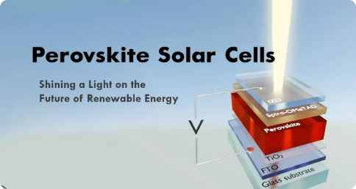

Perovskite Solar Cells
Notes:
1

Slide 2
Perovskite Solar Cells
Perovskite solar cells are a promising technology for solar energy conversion, using perovskite materials as the light-absorbing active layer. They offer high efficiency and potential for low-cost production compared to traditional silicon-based solar cells.
Features of Perovskite Solar Cells:
Perovskite Material:
The core component is a perovskite compound typically a hybrid organic-inorganic halide material (like lead or tin halides).
High efficiency:
Perovskite solar cells have demonstrated high power conversion efficiencies, reaching up to 25%.
Low Cost Production:
They are relatively easy to fabricate through solution processing, potentially leading to lower production costs compared to silicon-based cells.
Flexibility:
Perovskite solar cells can be made flexible, making them suitable for various applications.
Notes:
2

Slide 3
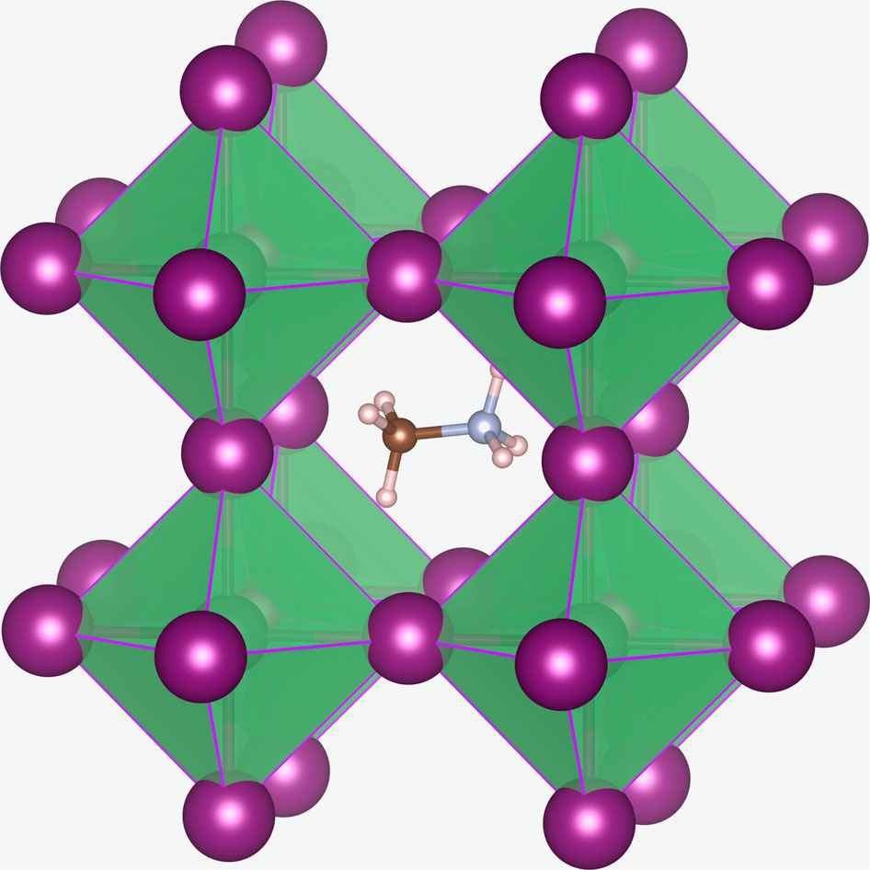
Structure / Materials Used
The name "perovskite solar cell" refers to the ABX3 crystal structure of the absorber materials, called perovskite structure, where A and B are cations and X is an anion. A cations with radii between 1.60 Å and 2.50 Å have been found to form perovskite structures.
Fig: Crystal structure of CH₃NH₃PbX₃ perovskites (X=I, Br and/or Cl). The methylammonium cation (CH₃NH₃⁺) is surrounded by PbX₆ octahedra.
Notes:
3

Slide 4
Terms related to perovskites
Jsc (short circuit current density)
Jshort-circuit, is a key parameter for evaluating the performance of a solar cell.
It represents the current density generated by the cell when it is under short-circuit conditions, meaning no external load is connected.
It essentially measures the maximum amount of photocurrent the cell can produce.
It is a crucial performance metric in solar cell technology. It's the current density (measured in mA/cm²) that the cell generates when the output terminals are shorted together.
Fill factor (ff)
The fill factor (FF) in perovskite solar cells is a crucial parameter that reflects the "squareness" of the J-V curve, indicating how well the cell converts light into power.
It's essentially the ratio of the maximum power output to the theoretical maximum power (short-circuit current multiplied by open-circuit voltage).
A higher FF means the cell's output is closer to the theoretical maximum, resulting in better power conversion efficiency.

Slide 5
Calculation:
FF = (Pmax / (Isc * Voc))
Where:
Pmax is the maximum power output of the solar cell.
Isc is the short-circuit current (the current flowing when the cell is not under load).
Voc is the open-circuit voltage (the voltage across the cell when no current is drawn).
Notes:
7

Slide 6
Thank you !

